Slide 1
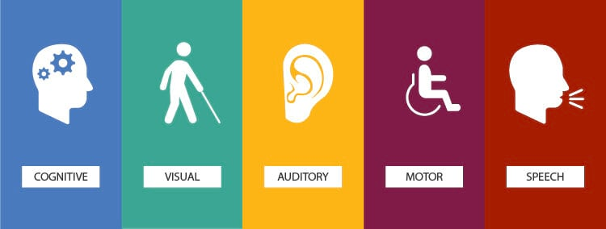

Accessibility in Web GIS
Crash Course on Adding Accessibility to Your GIS content Why It’s Important

Slide 2
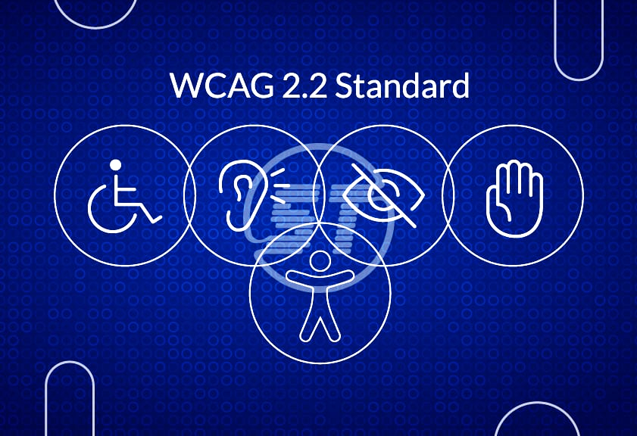
Accessibility in Web GIS
What is Accessibility?
3 Main Accessibility Points
WCAG 2.2
Accessibility Options in ArcGIS
StoryMaps
Dashboards
Experience Builder
Tips and Tricks for Accessibility
Notes:
Image Credit: WCAG 2.2 Demystified (https://www.skynettechnologies.com/blog/wcag-2-2-frequently-asked-questions-guide)

Slide 3
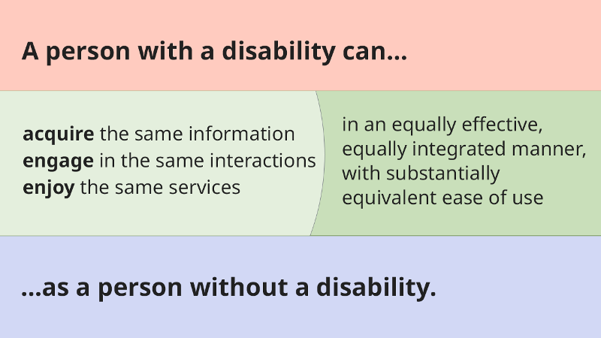
What is “Accessibility”?
Accessibility is the practice of ensuring your content is both usable and enjoyable by as many people as possible, regardless of impairments or disabilities.
The shorthand for accessibility is “A11Y”.

Slide 4
What is “Accessibility”?
Accessibility standards can be broken down into four basic principles:
Perceivable
Must be presentable to users in the ways they perceive the world.
Operable
User interface / navigation must be operable in more than one way.
Scrolling vs clicking vs tabbing with screen reader.
Understandable
Users must be able to understand the presented information and how to operate the user interface.
Robust
Content must be interpretable by a wide variety of users and assistive technologies.
Source: Introduction to Understanding WCAG 2.0
Notes:
Understandable
For example: if the instructions for using a web app or story map are within an image and not written as text, some users may have no idea how to operate the application if it has complexity to it

Slide 5
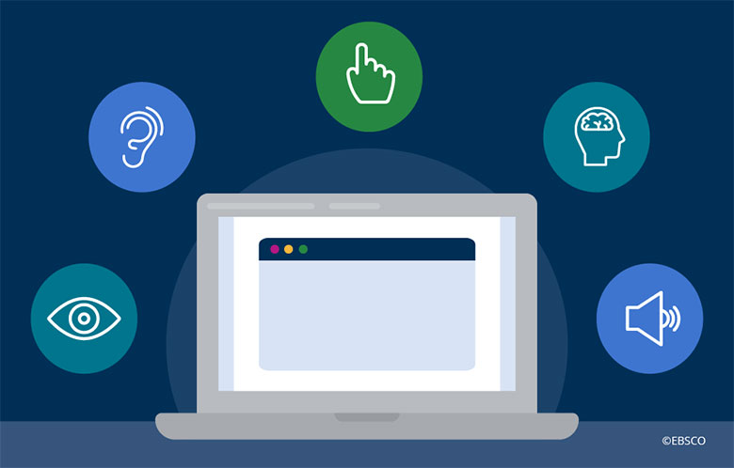
3 Main Accessibility Points
Screen Readers
Alternate Text
Captions
Hyperlinks
Color Blindness
Text colors
Embedded map colors
Visual Impairment
Text font
Text size

Slide 6
Screen Readers
Alternate Text
Describes image being displayed, and appears if image does not load
Captions
Describes media displayed above it or behind it
Hyperlinks
Proper formatting for screen reader
Ex: “For more information, go to the Monmouth County Website” instead of “https://www.visitmonmouth.com/” or “CLICK HERE”

Slide 7
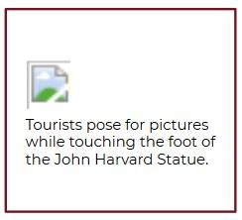
Alternate Text
Alt-text allows your media to be accessible to screen readers
Also forms a caption when the media does not load properly
It’s important to provide alternate text options for all images, videos, audio clips, and embedded content.
Remember to add alt-text to each piece of media if it is more than just decorative.

Slide 8

Alternate Text
How much alt-text should you write?
Bare minimum: "Person in a red jacket in the snow."
A little too descriptive: "A person in a neon red jacket and a hefty backpack kneels in the snow beneath a granite sky, peering through the telescopic lens of a tripod-mounted camera. His target is cluster of penguins camping out on a rocky outcropping several yards away."
Just right: "A person in a red jacket kneels in the snow, photographing some penguins on a nearby rock.”
Note: sometimes lengthy alt-text is necessary, especially if your image contains words that need to be read.
Source: Getting Started with Accessible Storytelling

Slide 9
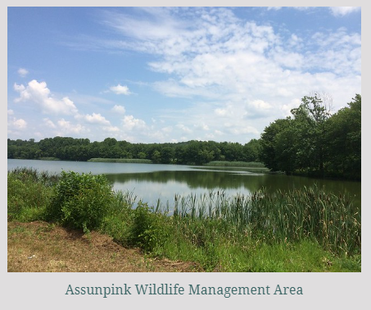
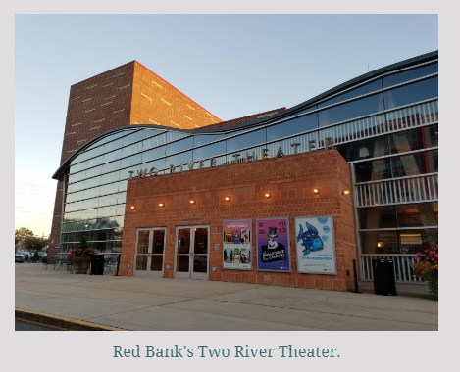
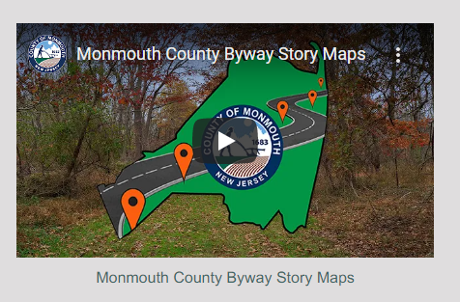
Captions
If alternate text is unavailable, captions are essential.
Not necessary if alternate text can be used, but helpful to add both just in case.

Slide 10
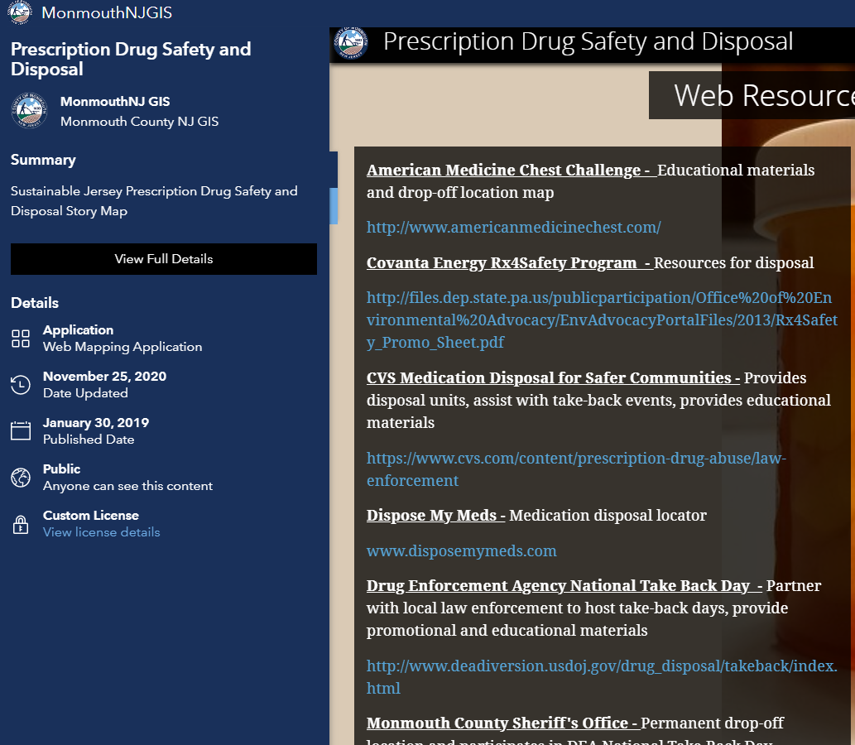
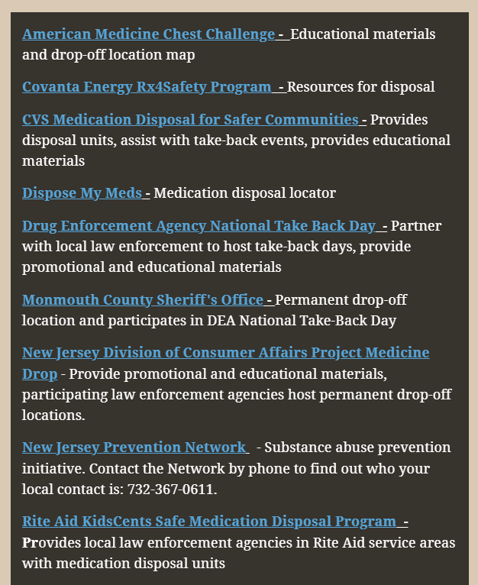
Hyperlinks
Original
Updated

Slide 11
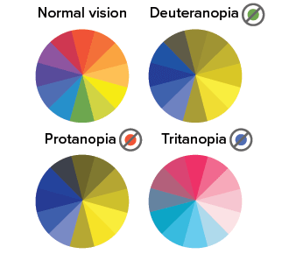

Color Blindness
Text colors
Changing the color of text against the background
Map colors
Changing the basemap colors
Changing the layer colors
Source: Getting Started with Accessible Storytelling

Slide 12
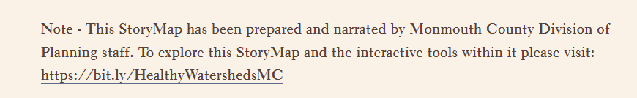

Text Color
Original
The hyperlink color should be changed to ensure links pop out from text.
Updated

Slide 13
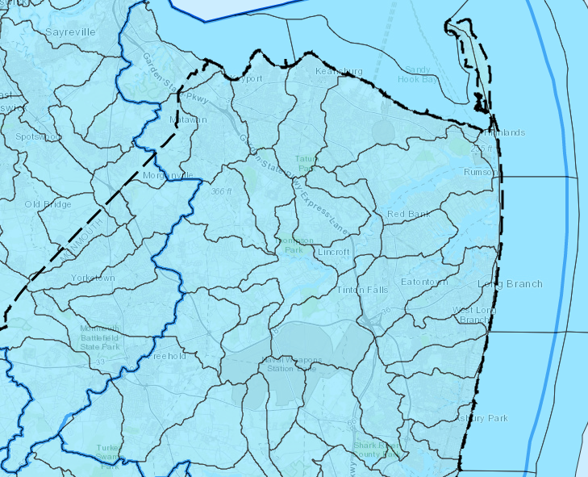
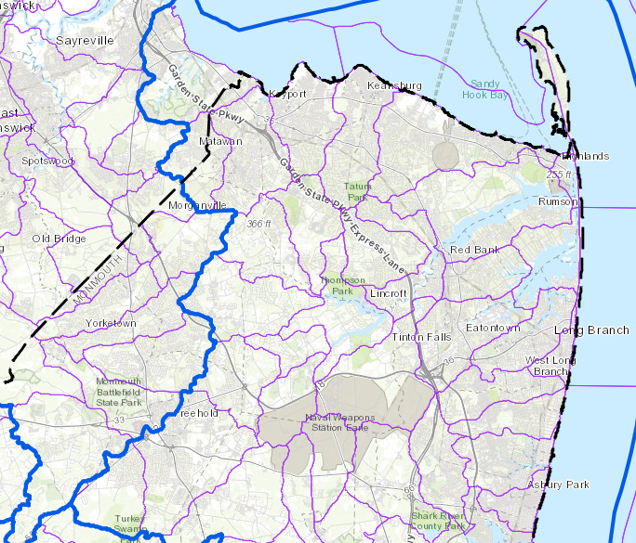
Map Colors
Original
Updated

Slide 14
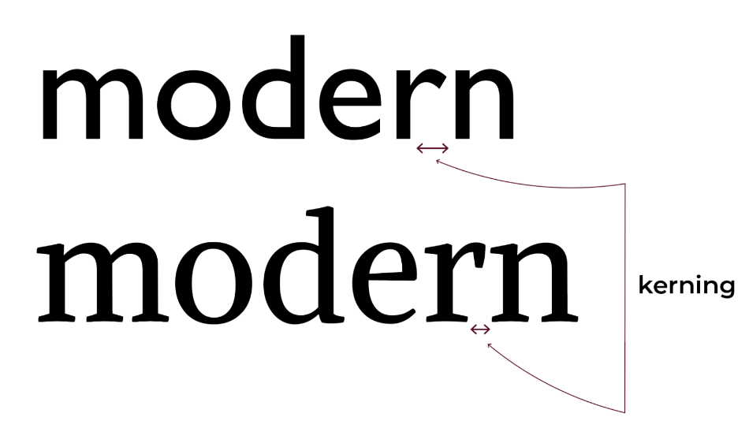
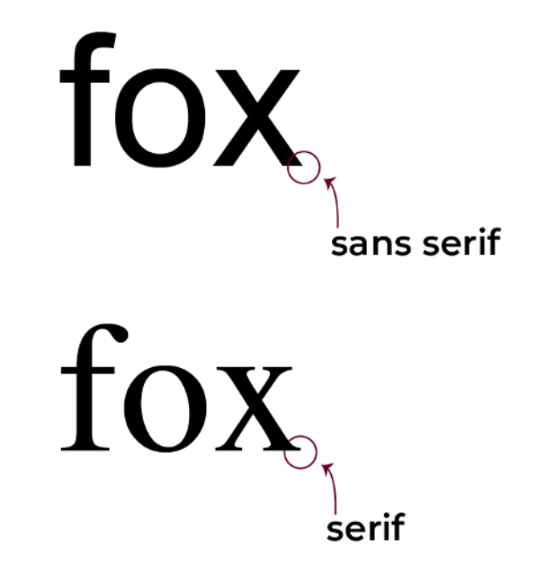
Visual Impairment
Text font
Ensuring the text font is legible
While Serif font is more elegant and stylish, San Serif font is easier to read.
Text size
Ensuring the font is at an easily readable size

Slide 15

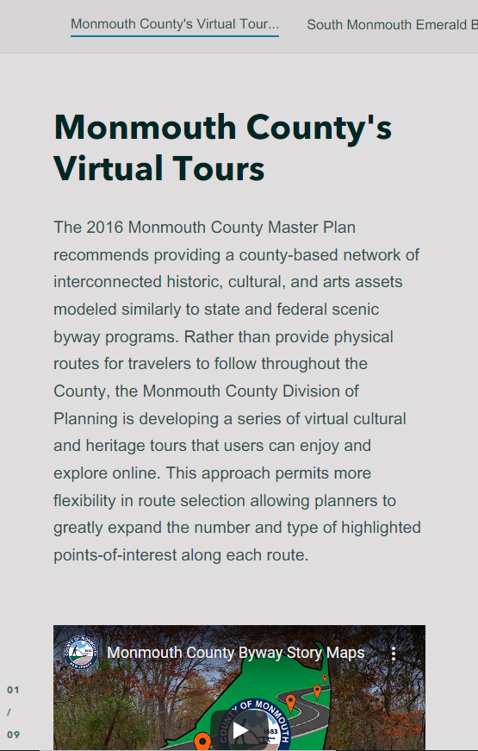
Text Size
Original
Updated

Slide 16

WCAG 2.2
WCAG (Web Content Accessibility Guidelines) sets the standard for accessibility in online content.
WCAG version 2.2 will take effect in April 2026.
Main Changes:
Focus Not Obscured
Focus Appearance
Target Size
Consistent Help
Redundant Entry
Accessible Authentication

Slide 17
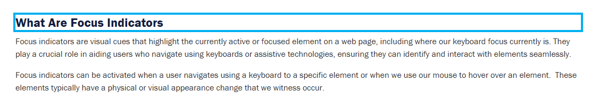
WCAG 2.2
Focus Not Obscured
Floating Headers should not obscure the “focus indicators” of screen readers.
This tells the user of a screen reader where on the page they are reading.
This is primarily an issue to look out for in ArcGIS Hub and Experience Builder.
Focus Appearance
The focus indicator must have a change of contrast between focused and non-focused states (meaning easily viewable on the page) and must be at least 2 CSS pixels thick.
This is primarily an issue to look out for in Experience Builder.
The blue outline around the heading is what the screen reader is “focusing on” (what’s presently being read) in this screenshot.
This box perimeter is 2 CSS pixels thick.

Slide 18
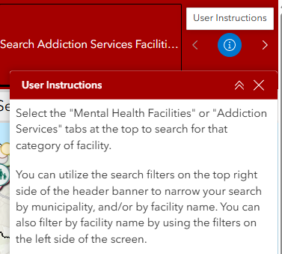
WCAG 2.2
Target Size
The minimum “target” (meaning a clickable button or link) size is 24x24 CSS pixels.
Consistent Help
Users can easily find help for what they’re looking for on a site.
An example of this is adding an instructional “About” section to any ArcGIS applications that helps explain what the app is and how it works.
24x24 pixels size

Slide 19
WCAG 2.2
Redundant Entry
Users should not have to enter the same information multiple times in a process (like filling out a form).
An example of this is ensuring enable auto-populating for things like Survey123 or Field Maps where applicable.
Accessible Authentication
Users can log in without solving cognitive puzzles like CAPTCHAs.
This applies if you’re considering adding CAPTCHA to your authentication on any ArcGIS apps.

Slide 20
Accessibility Options in Web GIS
StoryMaps
Dashboards
Experience Builder

Slide 21



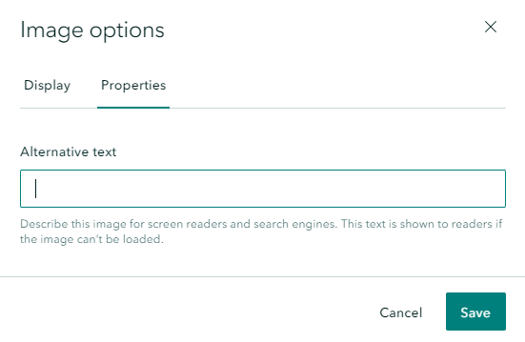
Alternate Text and Captions in StoryMaps
Over the media you insert, you will see this toolbar:
Clicking the cog opens an Image Options Window. Choosing the Properties tab lets you add Alternate Text:
A Captions option automatically shows up below any media you add:

Slide 22

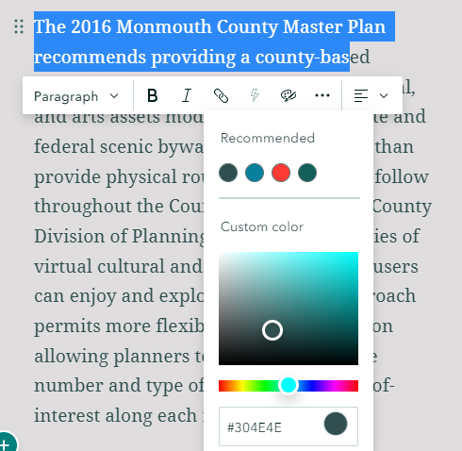
Color Blindness in StoryMaps
You can change the color of your text within the story directly.
Highlight the chosen text and choose the color pallete from the tool bar.
The StoryMap will suggest colors that match the theme, or you can enter your own.

Slide 23
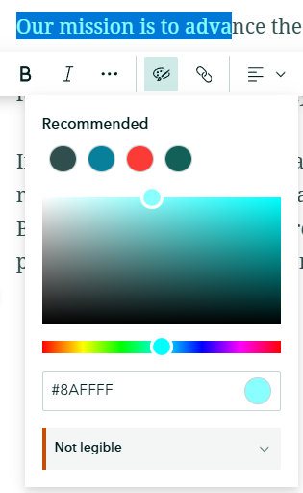
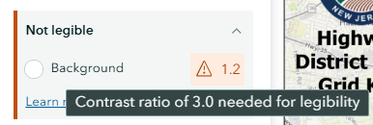
Color Blindness in StoryMaps
StoryMaps will also warn you if the color pallete you’ve chosen is not accessible.

Slide 24
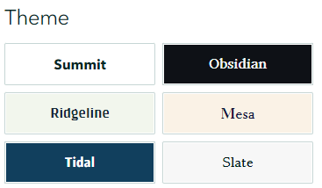

Color Blindness in StoryMaps
StoryMaps offers color themes that are designed to be useable even if someone is color blind.
When creating a StoryMap, choose the Design option on the top right of the screen:
This opens the Design tab. The Themes offered are listed below, and you can create your own theme if the presets do not work for your story.

Slide 25
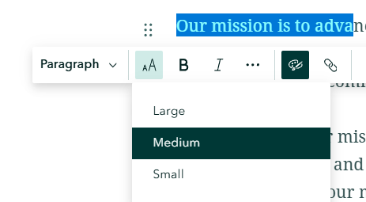
Visual Impairment in StoryMaps
Text size can be easily changed within the StoryMap body.
Highlight the text you wish to change and choose the size option from the drop-down.
Sizing options are restricted to “small”, “medium”, and “large” presets for accessibility purposes.

Slide 26
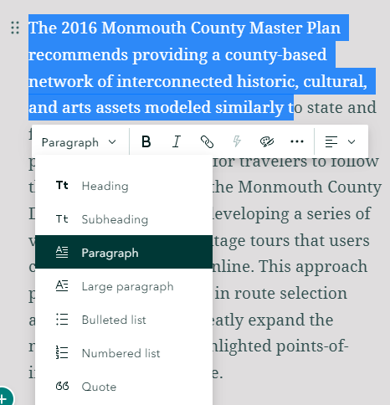
Visual Impairment in StoryMaps
You can also change text to different text “types”, such as headings, lists, and quotes.
Setting your StoryMap headings to “Heading” or “Subheading” is useful for screen readers, which will jump to headings directly.
It’s important not to set non-headings to a “Heading” type, as this will confuse the screen reader.
Note: When using a navigation bar in your StoryMap, all text set as “Heading” will appear in the navigation bar.

Slide 27
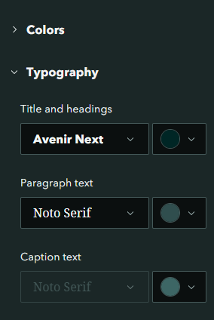
Visual Impairment in StoryMaps
Default text font and color can be changed when using a custom theme for your StoryMap.
Within your custom theme, use the typography tab on the left side of the screen to adjust font type and default color .

Slide 28

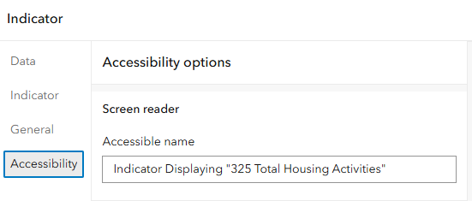
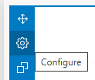
Alternate Text and Captions in Dashboards
Beside the dashboard elements you insert, you will see this toolbar:
Clicking the cog opens the Element Options Window. Choosing the Accessibility tab lets you add Alternate Text.

Slide 29

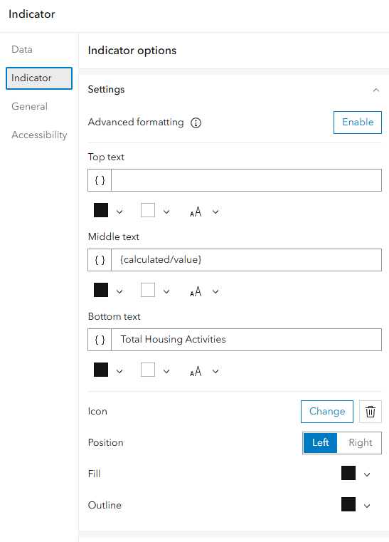
Color Blindness in Dashboards
You can change the color of your text and icons within your elements individually.
Within the Element Options window, you can adjust the color of the element and any text/items within it.
Note: Dashboards will not warn you if your color selection is not accessible. The “Tips and Tricks” discussed later will be helpful for checking this manually.

Slide 30
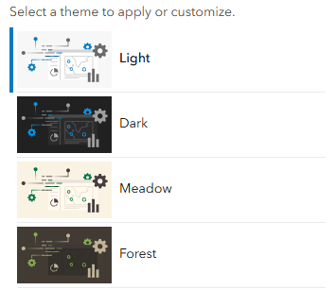
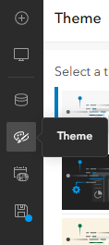
Color Blindness in Dashboards
Dashboards offers color themes that are designed to be useable even if someone is color blind.
When creating a Dashboard, choose the “color pallete” option from the toolbar on the top left:
This opens the Theme tab. Some of the Themes offered are listed below, and you can create your own theme if the presets do not work for your dashboard.

Slide 31
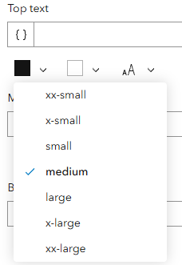
Visual Impairment in Dashboards
Text size can be changed within each dashboard element.
Open the Element Options window and adjust the font size for each component of the element.
Sizing options are restricted to presets for accessibility purposes.

Slide 32
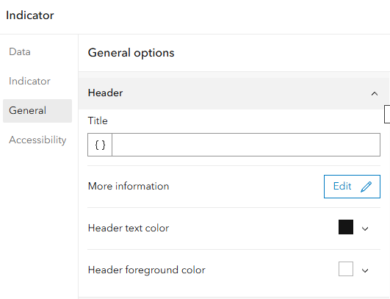
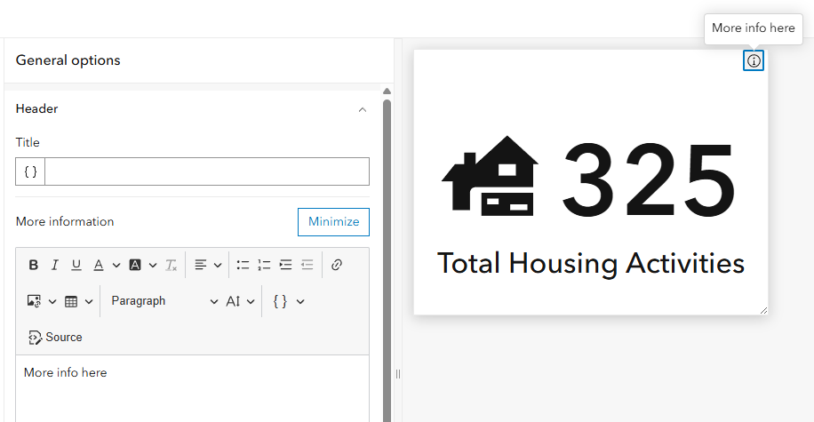
Visual Impairment in Dashboards
You can also set a Header for each element, as well as configuring a “More Information” section.

Slide 33
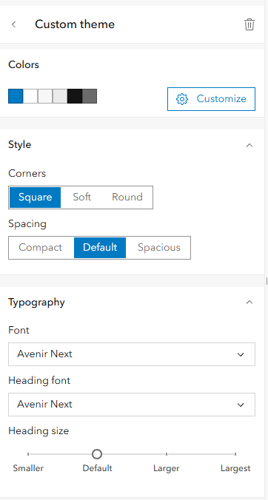
Visual Impairment in Dashboards
Default text font and color can be changed when using a custom theme for your Dashboard.
Within your custom theme, use the typography tab on the bottom of the screen to adjust font type.
Default colors can be adjusted within the “Colors” section at the top.

Slide 34

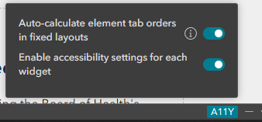
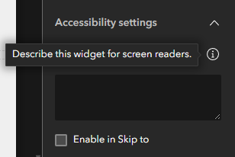
Alternate Text and Captions in Experience Builder
Accessibility options in Experience Builder are turned off by default!
When starting a new Experience, navigate to the bottom right of the screen to toggle on accessibility options via the “A11Y” button.
This turns on A11Y options for every widget in your Experience.

Slide 35

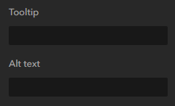
Alternate Text and Captions in Experience Builder
A widget description should be added to every widget in your Experience.
Widgets with the Alt-Text option should have the Alt-Text filled out instead.
Both are not needed.

Slide 36
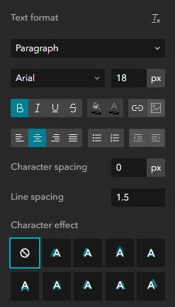
Color Blindness in Experience Builder
You can change the color of your text and widget icons within your widgets individually.
Within the Widget Options sidebar on the right, you can adjust the color of the widget and any text/items within it.
Note: Experience Builder will not warn you if your color selection is not accessible. The “Tips and Tricks” discussed later will be helpful for checking this manually.

Slide 37
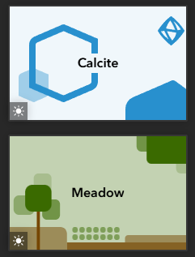
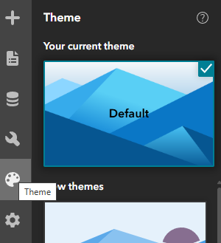
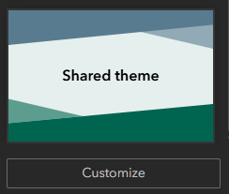
Color Blindness in Experience Builder
Experience Builder offers color themes that are designed to be useable even if someone is color blind.
When creating an Experience, choose the “color pallete” option from the toolbar on the top left:
This opens the Theme tab. Some of the Themes offered are listed below, and you can create your own theme if the presets do not work for your Experience.

Slide 38



Visual Impairment in Experience Builder
Toggling on the “Image Viewer” for Image widgets allows those with visual impairment to view the image at a larger size if needed.
It also provides a custom zoom tool on the image to be scaled to a custom size.

Slide 39
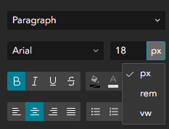
Visual Impairment in Experience Builder
Text size can be changed within each widget.
Open the Widget Options sidebar on the right and adjust the font size for each text component of the widget.
Sizing options are not restricted, which means it is important to keep accessible font size in mind.
Adjusting font to “rem” instead of “px” or “vw” is more accessible, because it scales the font size to the window size ratio.

Slide 40
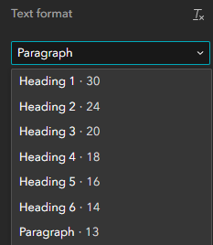
Visual Impairment in Experience Builder
You can also set headers for your experience as well.
Only one “Heading 1” should be used per Experience page (usually the title of the Experience itself).
The heading hierarchy descends from there, with subheadings using a lower heading number than the one “above” them.

Slide 41
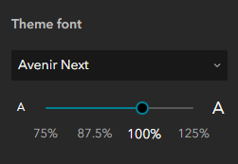
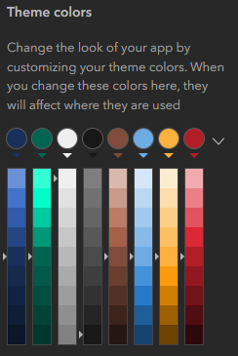
Visual Impairment in Experience Builder
Default text font and color can be changed when using a custom theme for your Experience.
Within your custom theme, use the “Theme Font” section on the bottom of the screen to adjust font type.
Default colors can be adjusted within the “Theme Colors” section at the top.

Slide 42
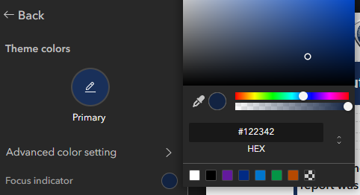
Visual Impairment in Experience Builder
You can also set the “Focus Indicator” color for the Experience under the “Theme”.
Remember that this color must be highly contrasted to be easily seen anywhere on the page!

Slide 43

Tips and Tricks for Accessibility
Browser Accessibility Checks
Press “F12” or “CTRL + Shift + i” to open the browser Dev Tools.
“Lighthouse” Accessibility Audit
Scans page for any accessibility needs and scores your compliance at the end.
“CSS Overview”
Looks specifically at visual accessibility needs and tells you what needs adjusting.

Slide 44
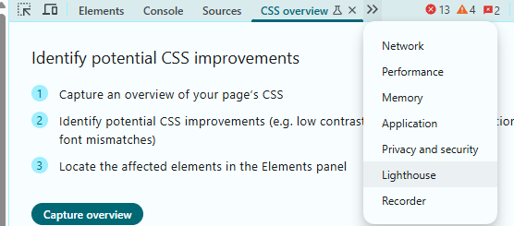
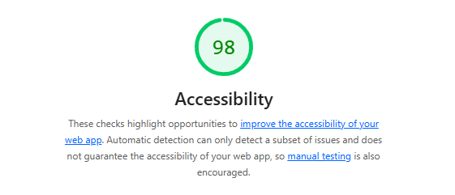

Tips and Tricks for Accessibility: Lighthouse
Beneath the score, suggestions are provided on the page with screenshots of what could be adjusted.

Slide 45



Tips and Tricks for Accessibility: CSS Overview
The “Contrast Issues” section is specific to A11Y visual contrast ratio requirements. Hovering over the color splotches will show where on the page needs to be adjusted.

Slide 46


Tips and Tricks for Accessibility
Testing with a Screen Reader
Testing your content with a screen reader allows you to see and understand the challenges that non-accessible content poses to those that rely on it.
Attempt to navigate your Web GIS content with a screen reader and listen to what is (and is not) presented to you.
Available free screen readers:
Narrorator (free with Windows OS)
Screen Reader browser extensions

Slide 47

Questions?
Resources for Accessibility in StoryMaps:
Getting started with accessible storytelling
Writing accessible ArcGIS StoryMaps content
Maps/Story Maps and Accessibility
Accessibility features – ArcGIS StoryMaps

Slide 48
Questions?
Resources for Accessibility in Dashboards:
Accessibility Best Practices for ArcGIS Dashboards
Accessibility Features in ArcGIS Dashboards
Improving the Accessibility of Your Dashboard
Dashboards That Pop: Accessibility
Dashboard Accessibility for Equitable Engagement

Slide 49
Questions?
Resources for Accessibility in Experience Builder:
Experience Builder Accessibility
Accessibility Best Practices for ArcGIS Experience Builder

Slide 50
Questions?
Other resources for Accessibility:
Free ESRI Course: Digital Accessibility Fundamentals
Resources for Digital Accessibility in ArcGIS
ESRI Accessibility Support

