Slide 1
The County of Monmouth
Benefits & Workforce Wellness Presentation

Slide 2

Wellness
Incentive Program

Slide 3
Program Overview
Holistic in nature
Rewards employees who choose to take control of their health & wellbeing
Earn wellness points for participation and/or completion of programs
1 wellness point = 1 chance in drawing

Slide 4



Program Details
Multiple opportunities per month to earn points
Drawings held quarterly
75 personal days off awarded each quarter
Limit of 1 personal day per person, per drawing
All days won must be used in calendar year of award.

Slide 5

Wellness Programs
Wellness Screenings/Preventative Health* (2 pts)
    Health Risk Assessment
    Biometric Screening
    Cancer Screening
    Vision/Dental/Hearing exams
    Blood Pressure screening
    Annual physical
    Vaccinations
  *Wellness screening form available on-line in Self Service under My Employee Forms & Memos, Benefit Forms, Wellness to complete and submit for credit. EOBs are also accepted.

Slide 6


Wellness Programs
Education (1 pt)
Wellness Webinars
Health Education Seminars
Financial Workshops
Weight Management/Nutrition (varies)
Walking Groups
Walk at Lunch/Health Fair
Workforce Wellness Program

Slide 7


Wellness Programs
Wellness Challenges (varies)
  Self Directed
Community* (1 pt)
  Donating Blood
  Volunteering
  Charity Race Participation
  *Volunteer/participation forms available in Self Service to complete and submit for credit.

Slide 8
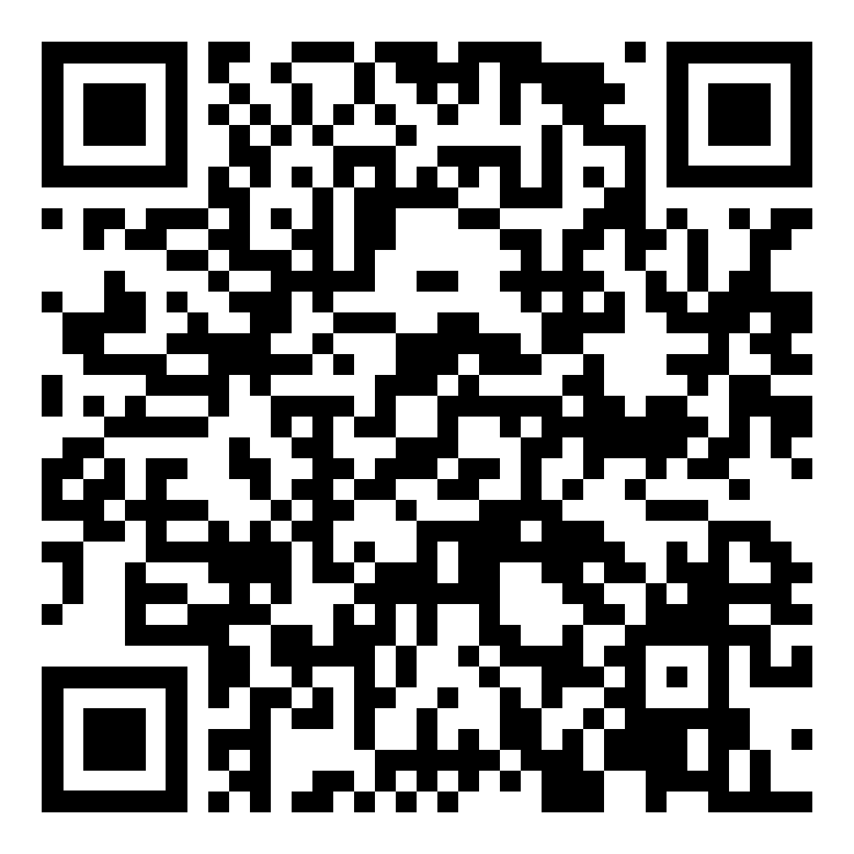
Wellness Program Registration
On-line registration
  Event Manager link in Self Service under Personal Assistant, Wellness Program Registration
  https://events.co.monmouth.nj.us/?agency=wellness
  Scan QR Code
  Direct link from outside provider
Phone registration
  Beth Helsby, Wellness Program Coordinator
  732-866-3622 Ext, 6135

Slide 9

Employee Assistance Program
(EAP)
Free, confidential counseling & referral service
6 free sessions per year
Toll Free Number: 1-877-747-1200
Available to all employees and household members
Provides 24 hour, 7 days a week Emergency Service
www.accessqhs.com or direct link on Employee intranet under EAP and in Self Service under Benefit Provider Links

Slide 10

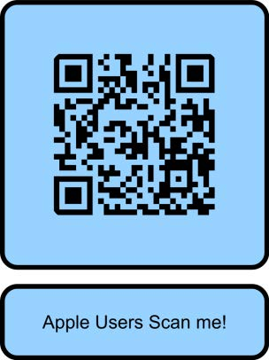
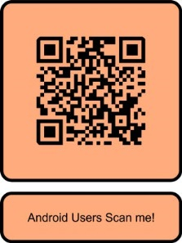
Access your EAP through the Self-Care. Connect Application.
Download the App using one of the QR codes below for Apple or Android users.
Once registered, you can connect with a Wellness Coordinator to work with a professional.
Access Code:
Monmouth

Slide 11
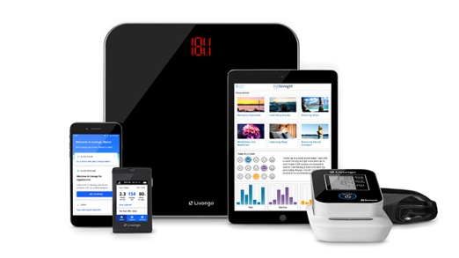
Wellness Programs
Disease Management
  Diabetes Management with Livongo®
  Hypertension Management with Livongo®
  Behavioral & Mental Health Support with SilverCloud
  Musculoskeletal Management with Hinge Health
  Weight Management with Omada

Slide 12
The County of Monmouth
Health Benefits Presentation
Benefits Department: 732-866-3622
JoAnna Tumminello Ext. 6671
Anna Chamberlain Ext. 7737

Slide 13
Healthcare Plan Overview

Slide 14
Omnia PPO Overview
We offer Horizon Omnia Blue Cross Blue Shield of NJ.
This is an in-network only PPO plan (Preferred Provider Organization).
Providers contracted in this plan are categorized as Tier 1 or Tier 2.
Telemedicine Program available 24/7/365
Panorama III vision plan (Aka Davis Vision) coverage at no extra paycheck deductions.
  Enrollment form for Vision Coverage still needed.

Slide 15
Omnia Tier Coverage Overview
  Tier 1
  PCP copay $5
  Specialist copay $15
  No deductibles
  Tier 1 Hospital copay $150
  Tier 2
  PCP copay $20
  Specialist copay $30
  Tier 2 Deductibles:
    $1,500/$3,000
  Tier 2 Hospital copay $100
  Blue Card coverage while traveling

Slide 16
Tier 1 Hospitals
CENTRASTATE
BAYSHORE MC
JERSEY SHORE UMC
RIVERVIEW MC
MONMOUTH MC
COMMUNITY MC
MONMOUTH MC TR
OCEAN MC PT PL
OCEAN MC
MONMOUTH MC SC

Slide 17
Prescription Plan Express Scripts
Excellent Rx coverage for you & your eligible dependents
Included with County medical plan coverage.
If an eligible employee declines health benefits, he/she may enroll in just the prescription plan at a minimal cost.
Enrollment in Express Scripts needed if activating RX benefits only
Co-Payments
Retail (30 Day Supply) | Mail-In Service (90 Day Supply)
$20 Co-Pay – Brand Name | $15 Co-Pay – Brand Name
$5 Co-Pay – Generic | $0 Co-Pay - Generic
PBA 314: Co-Pays are an additional $5 in Generic | $15 Co-Pay – Brand Name $0 Co-Pay - Generic

Slide 18
Express Scripts Contact
www.express-scripts.com
1-800-711-0917

Slide 19
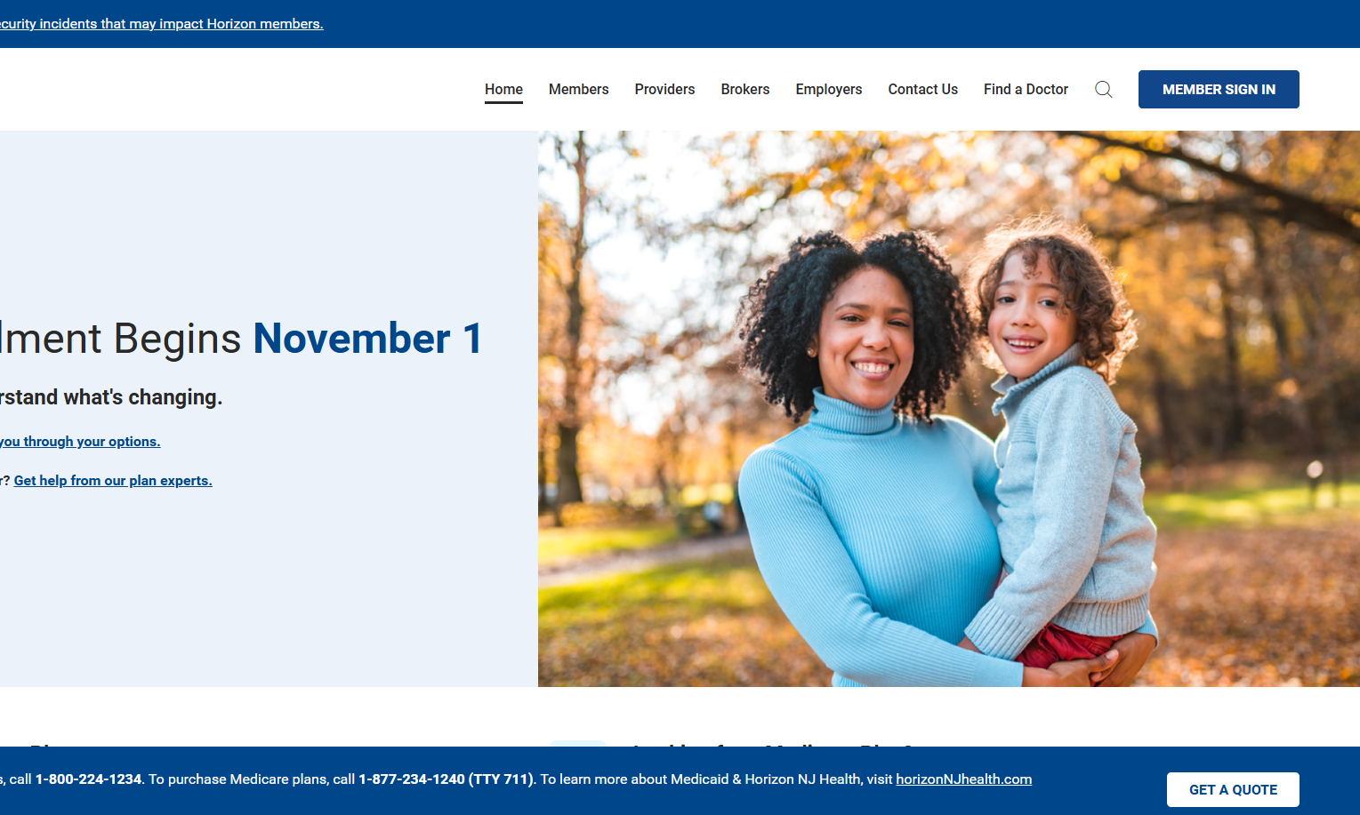
Find a Doctor (BCBS)

Slide 20
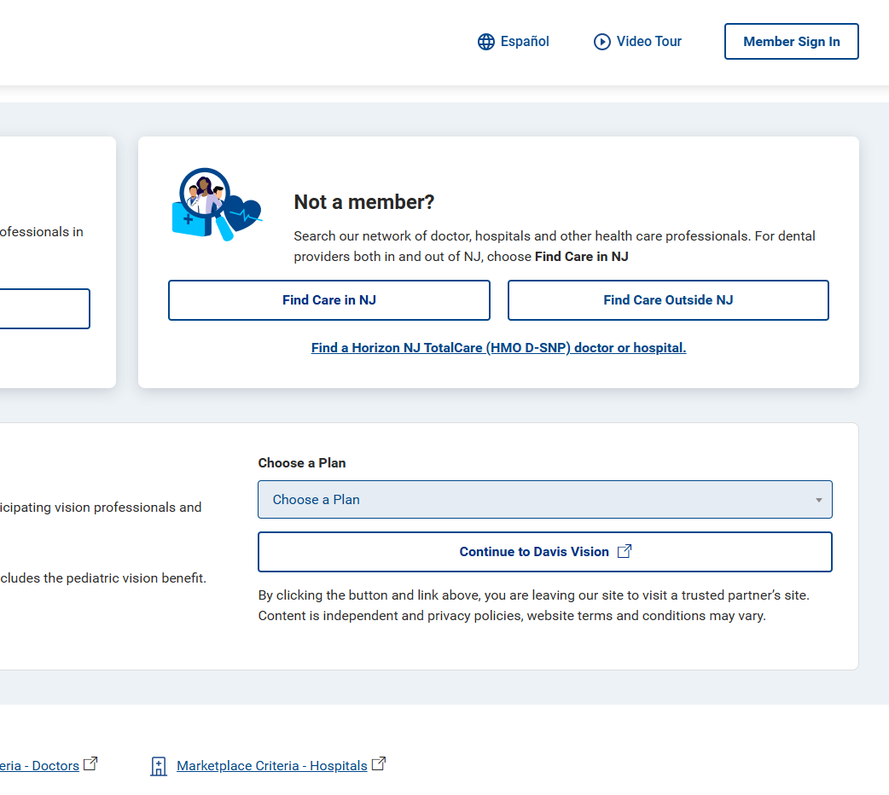

Slide 21
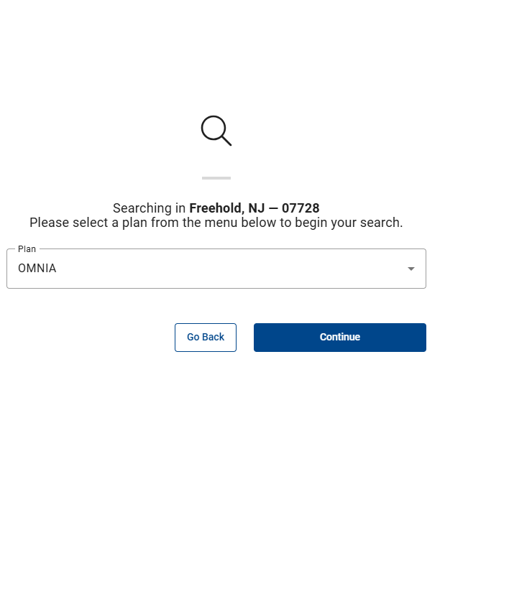

Slide 22
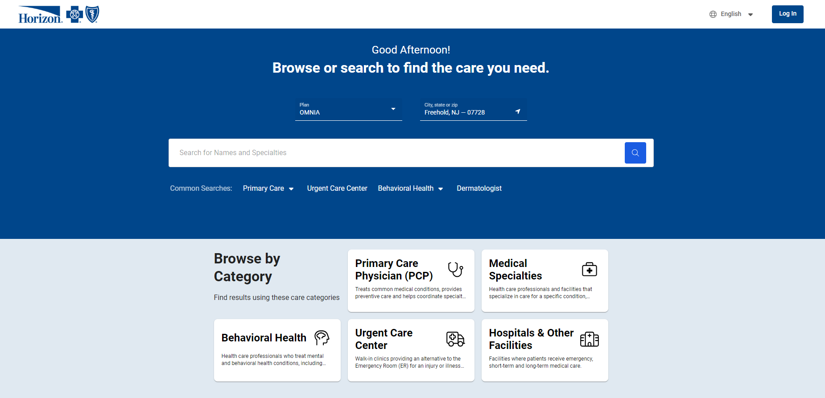

Slide 23
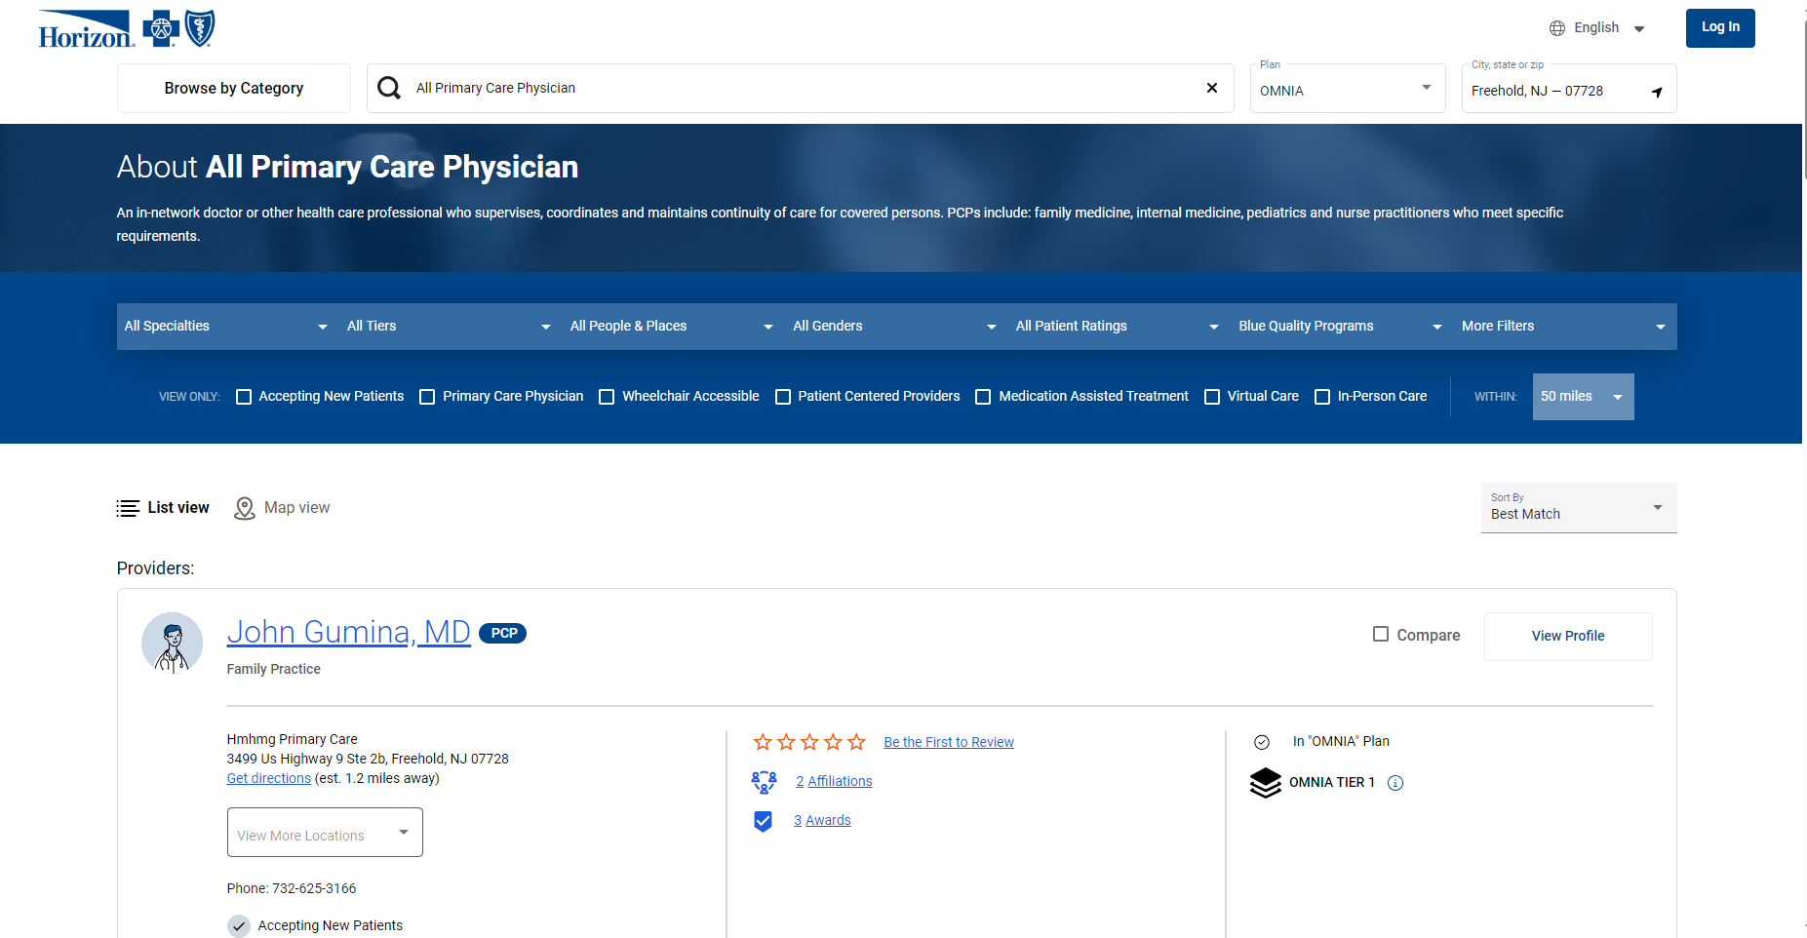

Slide 24
Enrolling Dependents
Spouse or Civil Union Partner
Child
Stepchild
Adopted child
Evidence of relationship and identity are required. If proof of relationship/identity are not received by start date of benefits, they will be terminated until such time as proof is provided.
Legal Guardianship
You can cover the following individuals on your County of Monmouth health, prescription, dental, and vision plans:
Birth Certificates
Marriage and/or Civil Union Certificates
Social Security Cards
Legal paperwork if fostering, adopting or obtaining legal guardianship
Documentation of shared address/assets

Slide 25
IMPORTANT! Qualifying Life Events
If you have a change in status, e.g. Marriage, Divorce, Birth or Adoption, etc., the new dependent must be added to your health coverage within 30 days of the event.
If you do not enroll additional family member within 30 days of the event, you must wait until the next Open Enrollment!
To make a change in your status for any of the above reasons contact the Division of Benefits & Workforce Wellness.

Slide 26
Dental & Vision Plans

Slide 27
Plan I Horizon Dental CHOICE
Deductible | None
Choice of Dentists | Must use their network of Dentists (limited) See www.horizonblue.com
Annual Benefit Maximum | Unlimited
Coverage
Preventive | 100%
Basic | 100%
Major | 50%
No Orthodontic Benefit or Out of State Coverage Dependent Children are covered until age 26 (End of Month)

Slide 28
Plan II Horizon Dental OPTION
Deductible | $25/person $75/family
Choice of Dentists | Select any dentist you choose (in and out of network)
Annual Benefit Maximum | $2,000/person
Coverage
Preventive | 100% of Maximum Allowable Charge (MAC)
Basic | 80% of MAC
Major | 50% of MAC
No Orthodontic Benefit Dependent children are covered until age 26 (End of Month) Out of State Coverage available

Slide 29
Plan III DSO-Dental Services Organization
Deductible | None
Choice of Dentists | All services available at Eastern Dental
Annual Benefit Maximum | Unlimited
Coverage
Preventive | 100%
Basic | 100%
Major | Covered 100 % after $175.00 deductible
Orthodontic coverage available- $1300 stainless steel (child)/$2500 adult Dependent children can stay enrolled until age 26 (End of Month)

Slide 30
Feature | Dental Choice | Dental Option | DSO
Deductible | None | $25/person $75/family | None
Choice of Dentists | In Network only | In & Out of network | Eastern Dental locations only
Annual Benefit Maximum | Unlimited | $2,000 annual per person | Unlimited
Coverage | In State only | In & Out of State | In State only
Preventive | 100% | 100% of Maximum Allowable Charge (MAC) | No Cost
Basic | 100% | 80% of MAC | No Cost
Major | 50% | 50% of MAC | $175.00
Orthodontic | None | None | $1300 stainless steel (child)/$2500 adult

Slide 31
Enrolling in Dental Plans
If enrolling in Dental CHOICE, please contact BCBS with information of preferred dentist once coverage is approved/active. Otherwise, you will remain with the assigned practice given by BCBS.
If enrolling in the DSO Plan, please include name of office location on the enrollment form in Section D of the enrollment form
Payroll deductions begin one month prior to coverage effective date
If you belong to a Union, wait until you meet with your Union representative to see if an additional dental offering is available before making any dental elections

Slide 32
Voluntary Vision Plan
Davis Vision (aka Panorama III Alt B)
  Eye Exam – Every 12 months
  Contact Lens Fitting
  Available with OMNIA medical plan with no additional payroll deductions
  Completed Vision form is required to enroll

Slide 33
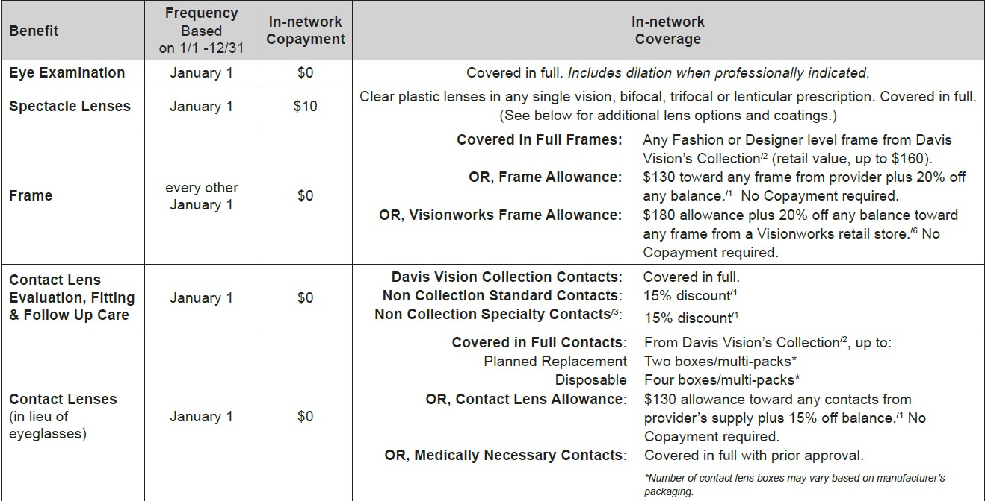
Davis Vison Summary Plan

Slide 34
Davis Vision Contact
davisvision.com
1-800-278-7753

Slide 35
Flexible Spending Accounts

Slide 36
Flexible Spending Account
Medical Reimbursement
Voluntary Contribution through Payroll Deduction
  Card is front loaded and paid through biweekly pay checks
Pre-Tax Savings
  Minimum Contribution: $240 /year
  Maximum Contribution: $3,330/year
Use for:
  Vision Wear
  RX & Medical Co-Payments
  Qualifying non-reimbursed medical and dental expenses
Cautiously determine your voluntary contribution. “Use it or lose it!”

Slide 37
Flexible Spending Account
Dependent Care Reimbursement
Voluntary Contribution through Payroll Deduction
Pre-Tax Savings
Use for:
  Child Care & Summer Camp Facility Tuition
    Up to age 12
  Approved Care Costs for Elderly / Dependent Needs
Cautiously determine your voluntary contribution. “Use it or lose it!”

Slide 38
Transportation & Parking
The IRS allows employees to pay for eligible transportation expenses with pre-tax dollars. Qualified expenses are those for mass transit, parking at or near your work location, or commuter parking near a transit stop or station.
This is for the employee only and cannot be used by family members.

Slide 39
Disability Compensation

Slide 40
Temporary Disability Compensation
Eligibility
  Must work a minimum of 20 hours/week
  Must have been employed for six months
  Must provide proof of disability for non-job-related illness or injury, which extends for a minimum of 15 days
100% County-funded
  Therefore, no deductions made for SDI Taxes
Eligible employee receive a maximum of $300/week for up to 52 weeks with an approved leave of absence.
You will be billed for your contribution to the health insurance as well as any voluntary benefits, i.e., dental

Slide 41
Additional Disability Insurance
Voluntary Disability Insurance
  Contribution based on salary, age, and amount of accumulated sick time
  Guaranteed issue for new employees
  Receive up to 60% of salary while on disability
  Runs concurrent with Temporary Disability Compensation
  Enrollment is completed directly through Colonial Life

Slide 42
Other Colonial Life Voluntary Benefits
Accident
Critical Illness
Cancer Insurance
Long Term Disability
Hospital Indemnity
All plans are portable after employment ends
For all Colonial Life Voluntary benefits, go to:
Self Service→ “My Employee Forms and Memos”→
“Benefit Forms”→”Voluntary Benefits”

Slide 43
Additional Life Insurance
Voluntary Universal Life Insurance
  Select the benefit amount that meets your specific needs
  Offered on an after-tax basis
  Opportunity to insure your spouse as well

Slide 44

Colonial Life Voluntary Benefits
Lauren Perri
856-983-9600 x101
www.coloniallife.com

Slide 45

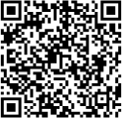
Aflac Pet and Supplemental Dental Insurance Plans
To see the benefits available under the Aflac Plans, scan the QR Code or link below.
https://www.aflacenrollment.com/CountyofMonmouth/qqq031429134

Slide 46
NJ Pensions & Benefits

Slide 47
NJ Division of Pensions and Benefits
PERS, Public Employees’ Retirement System
DCRP, Defined Contribution Retirement Program
PFRS, Police and Fireman Retirement System
Membership is required for Permanent County employees
  Exception: If you are currently collecting from a different NJ State Pension Program
Provisional employees will automatically be enrolled once appointed OR after 12 months of continuous service.

Slide 48
I. PERS
Enrollment requires a minimum of 32 hours per week for Local Government Employees
Must earn at least $8,300/year
Employee contribution
7.5% of annual salary over 24 pay periods
Contributions are tax deferred

Slide 49
II. PFRS
County Correction & Sheriff’s Officers
Employee contribution
10% of annual salary (if full-time)
Contributions are tax deferred

Slide 50
PERS & PFRS – Beneficiaries
Employees are responsible for selecting beneficiaries once they receive a membership I.D.# and Pension booklet via the State from NJDPB (takes approximately 2-4 months).
Done via online through Member Benefits Online System (MBOS) new user, register at: www.state.nj.us/treasury/pensions.
If not completed, the “Member’s Estate” will automatically be the beneficiary of record.
Employees can view their Personal Benefit Statements in MBOS which are posted quarterly. Be sure to keep login information in a safe place.

Slide 51
Group Life Insurance - PERS or PFRS
Automatic enrollment for employees enrolled in PERS or PFRS
Survivor Benefit Coverage of Active Members
PERS
  3 times your annual salary (last 12 months of employment)
The County & Employee equally share contribution
  Employee contribution = 0.5% of annual salary
  Employee may withdraw from personal contribution after one year of service.
  Benefit is then reduced to 1 ½ times your annual salary with no future opportunity to enroll
PFRS
  3 1/2 times your annual salary
  No employee contribution

Slide 52
Pension Loans
Eligible after 3 years & 3 months of participation
May borrow up to 50% of your accumulated total twice per calendar year
For eligible borrowers, the interest rate for pension loan applications received in 2026 will be 9.25% per annum on the declining balance of the loan.
Administrative processing fee is $15.00.
Note that the administrative processing fee is not an added charge but is taken from the requested amount of the loan.

Slide 53
The DCRP provides eligible members with a tax-sheltered, defined contribution retirement benefit, along with life insurance and long-term disability coverage
Membership is required
Includes Appointed or Elected Officials
Employees that earn over $176,100 (surplus goes into DCRP, this can be waived)
Employees that work less than 32 hours and earn at least 5K/year
5.5% of annual salary taken from paycheck deductions
III. DCRP

Slide 54
DCRP Employer Paid Life Insurance
1.5 times the annual base salary (medical examination required for 60 years or older)
Vested after 1 year of participation
Requires appointing a beneficiary
  Booklet will be sent to you with instructions.
Long-term disability coverage
  Employer-paid after one year of participation.
Employees will receive further information from Empower Admin

Slide 55
Monmouth County Health Policies

Slide 56
Family & Medical Leave Policy
Federal & State – 12 weeks of unpaid leave for approved absences.
Eligibility for Leave: Worked 1,000 hours and employed 12 months.
NJ Family Leave Insurance (NJFLI)
For additional information visit www.nj.gov/labor
  Only eligible if carrying for a family member/baby bonding
Family Leave Insurance benefits payable through the NJFLI up to maximums allowed by the State at the time of leave.
Leave forms are located in Self Service under My Employee Forms & Memos, Leave Forms

Slide 57
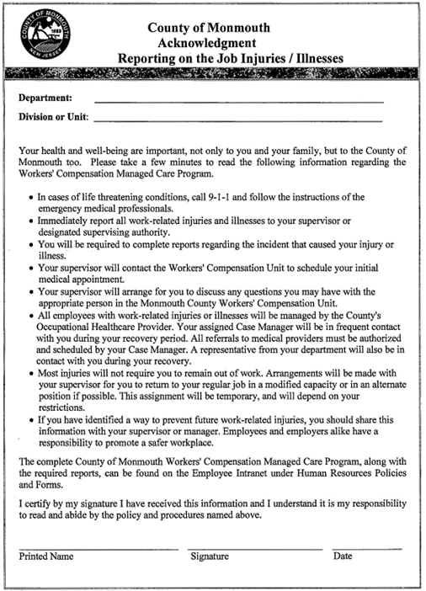
Reporting on the Job Injuries/Illnesses

Slide 58
Patient Protection & Affordable
Care Act (PPACA)
Passed in May of 2010. There are many provisions to the law. Among them are as follows:
  Created public & private insurance exchanges where healthcare plans can be purchased.
  Requires that employers notify their employees of the existence of these exchanges.
  Requires everyone to have health benefits or pay a penalty.
  Monmouth County coverage is considered affordable & creditable under this law.
  The County does not administer these plans under PPACA
  Visit HealthCare.gov for more information.

Slide 59
Public Service Loan Forgiveness
Some student loans may qualify for Public Service Loan Forgiveness (PSLF)
Full time County employees who make 120 qualifying payments may be eligible to have the remainder of their loan forgiven
For more information, please visit StudentAid.gov

Slide 60
Benefit Enrollment: Next Steps

Slide 61
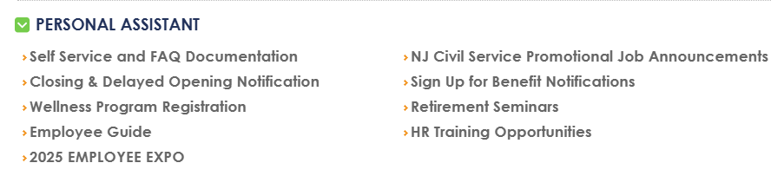
Benefit Notification Sign-Up
Learn about upcoming Wellness Programs, Voluntary Benefits and Open Enrollments for your healthcare policy offerings
How to:
  Log into your Self-Service portal.
  Under “Personal Assistant”, click on “Sign Up for Benefit Notifications”.
  Enter the requested information and begin receiving valuable notifications that will provide useful information to help you and your dependents maintain optimal levels of good health!

Slide 62
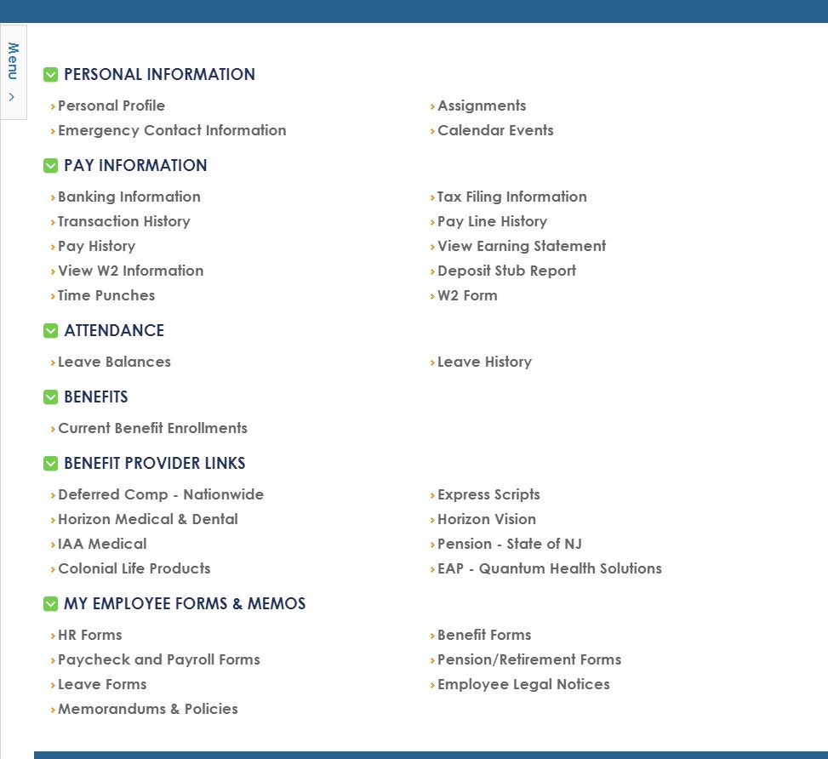

Slide 63
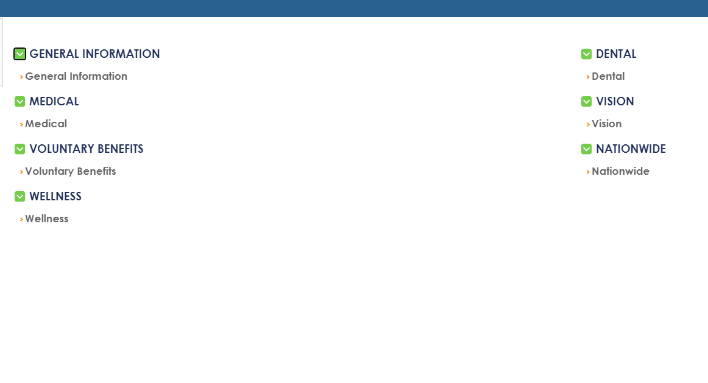
General Open Enrollment Information
FSA & Colonial Life Open Enrollment Information

Slide 64
IMPORTANT ENROLLMENT INFORMATION
Completed enrollment forms must be submitted within 7 days of this Orientation.
4 options to send paperwork:
  Scan and email to Enrollments@co.monmouth.nj.us
  Send via inter-office mail to HR—Benefits
  Fax to 732-780-3364
  Stop by and see us! (Hall of Records Annex)
Do NOT delay! Next opportunity to enroll is during Open Enrollment.

